Slide 1



DATAMIND
…Empowering Your Future with Data

Slide 2


Ministry of Communications and Information Technology
Digital Egypt Pioneers Initiative
MICROSOFT POWER BI ENGINEER TRACK
GRADUATION PROJECT

Slide 3


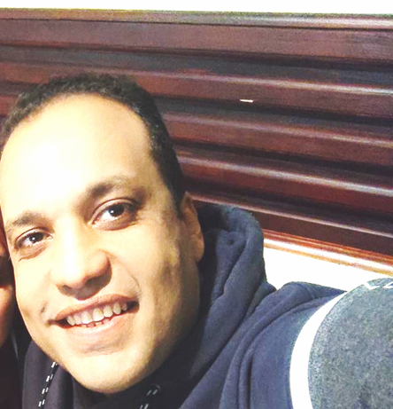
GREETING

Slide 4
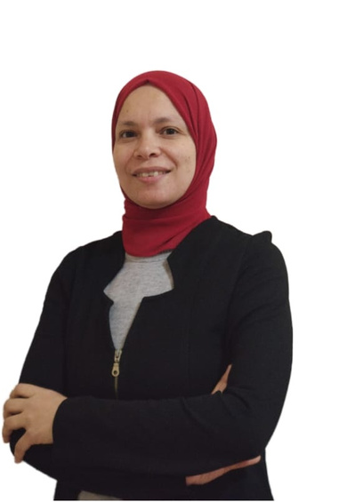
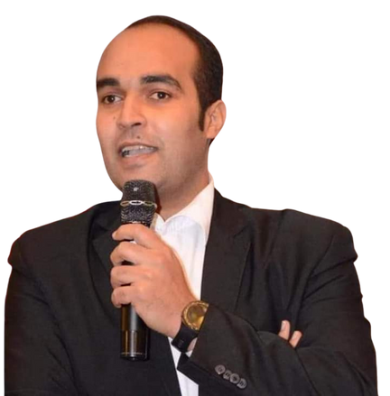
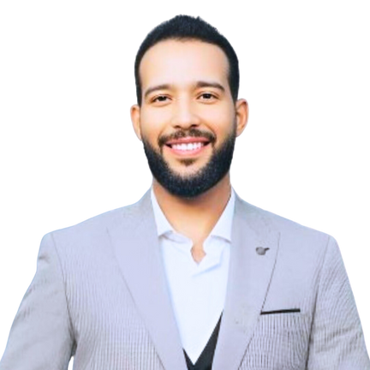

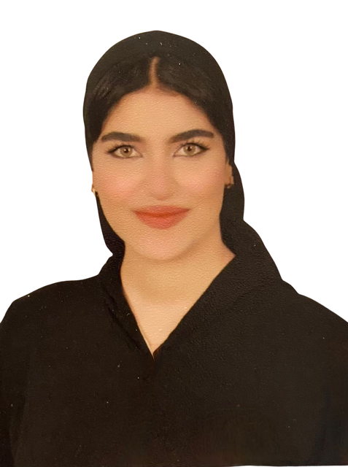
Meet Our Team
MARWA
AHMED
YOUSSEF
ZEINAB
ALAA

Slide 5





CONTENT
Policy,
Agreeement & Overview
Dataset
Cleaning &
Preparation
Data Modeling
Creating
Dashboard
Discussion

Slide 6
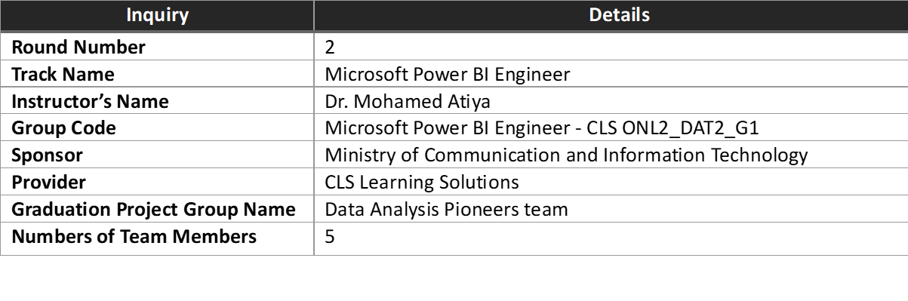

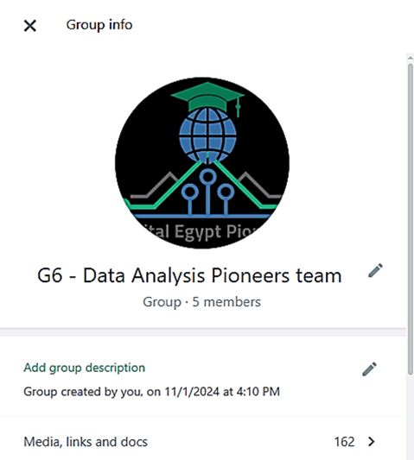
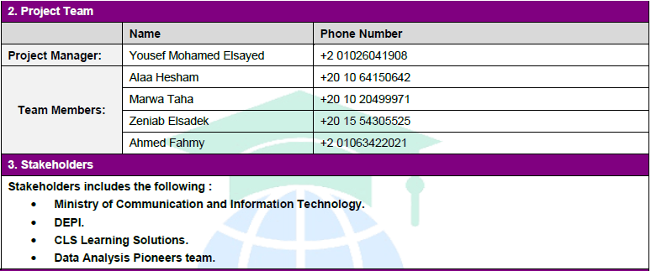
Policy,
Agreement
& Overview

Slide 7
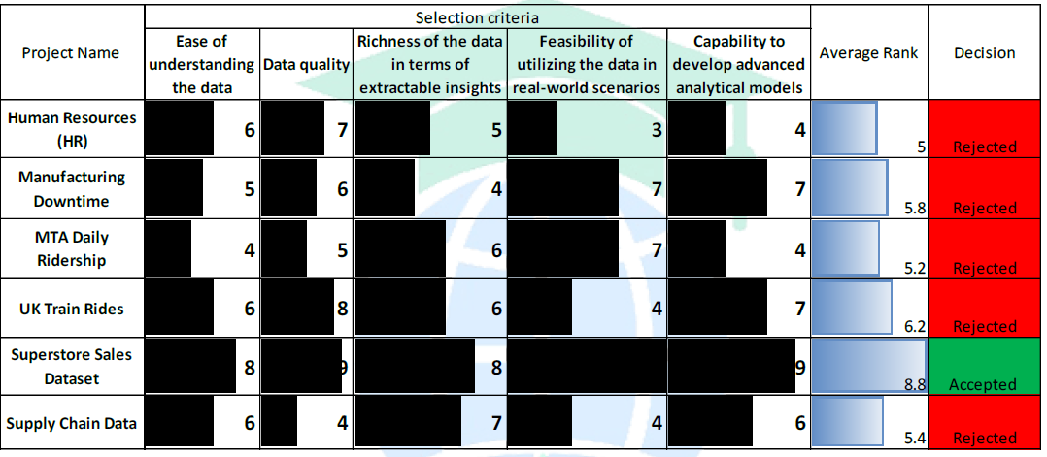
Project Selection

Slide 8
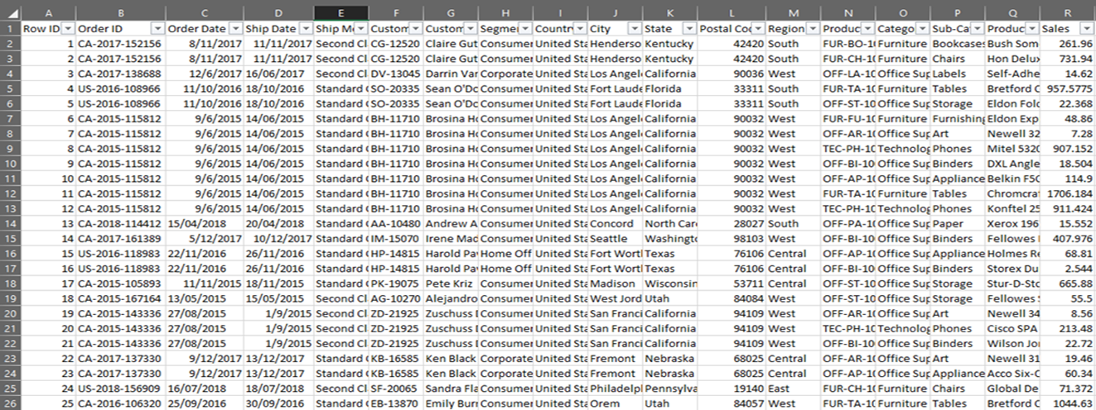
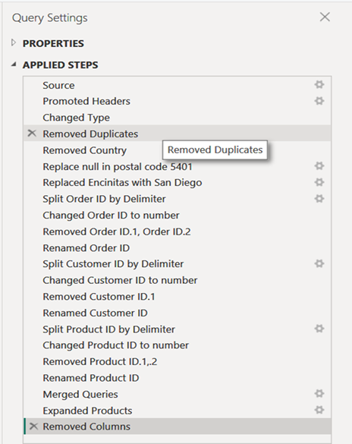
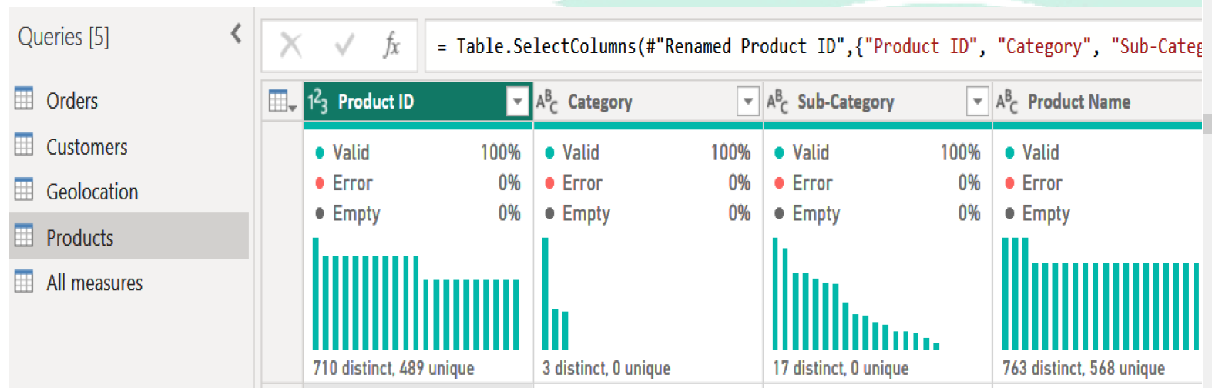
Dataset
Cleaning
& Preparation

Slide 9
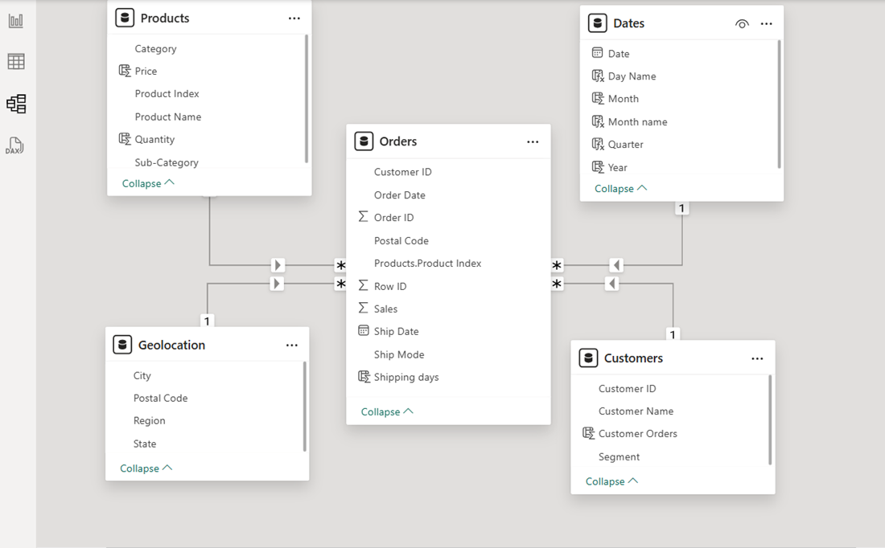
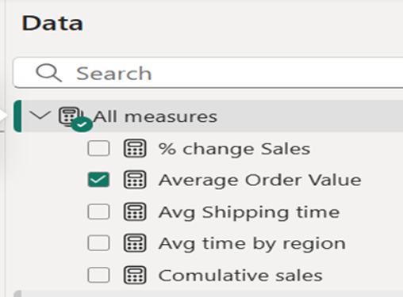
Data
Modeling

Slide 10
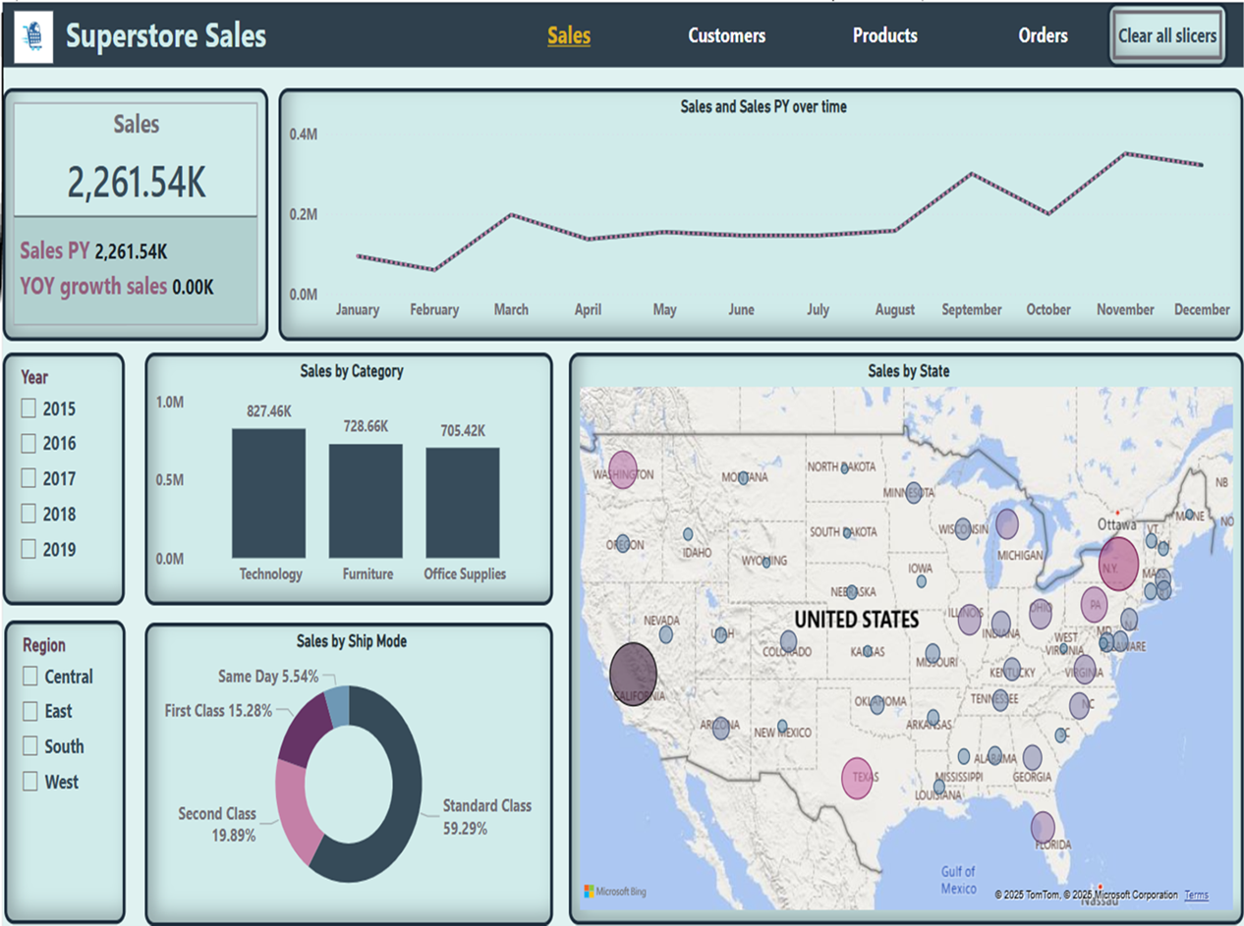
Creating Dashboard

Slide 11
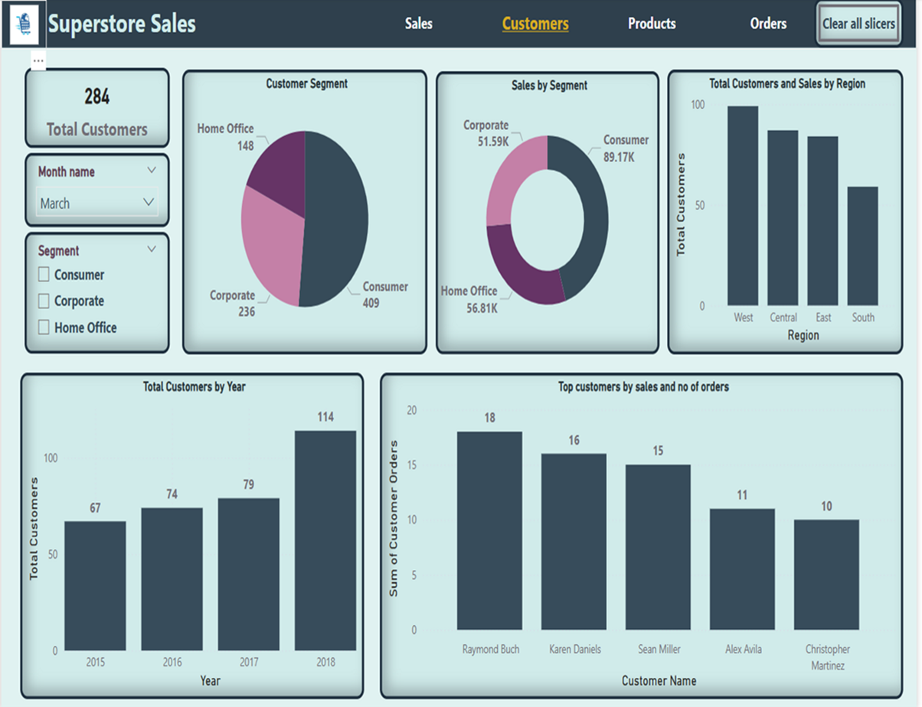
Creating Dashboard

Slide 12
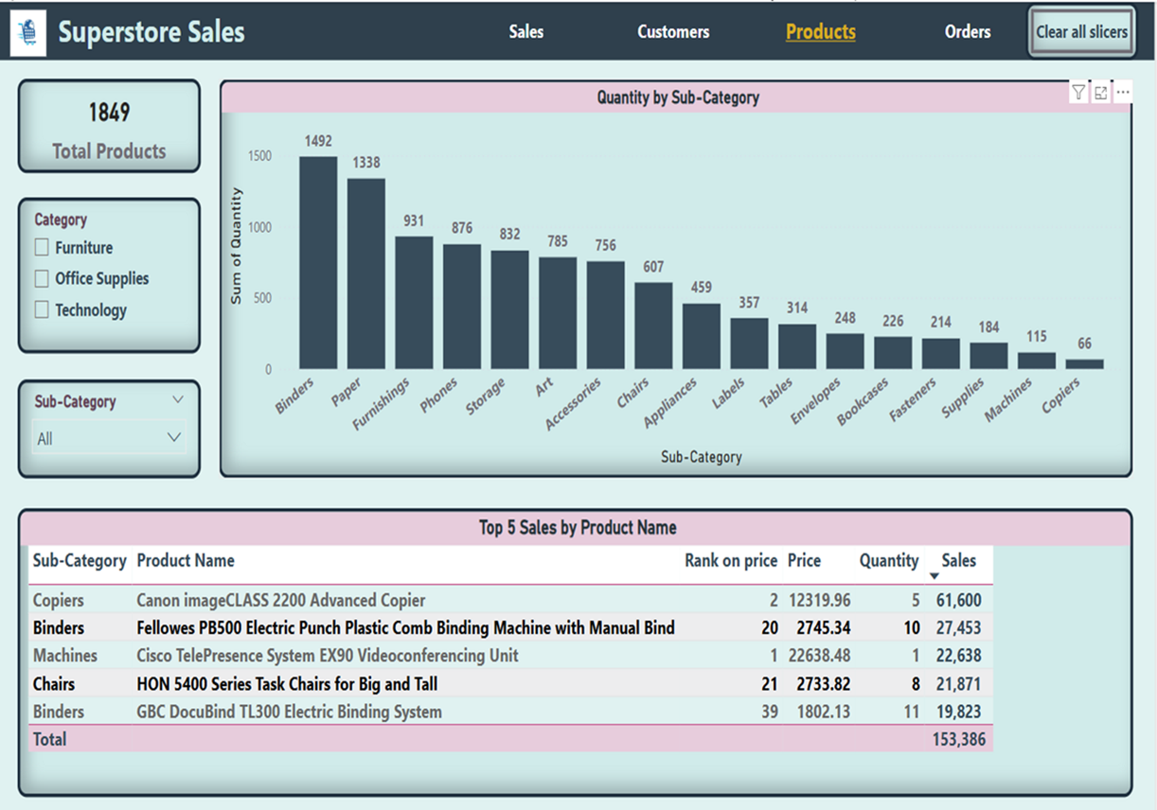
Creating Dashboard

Slide 13
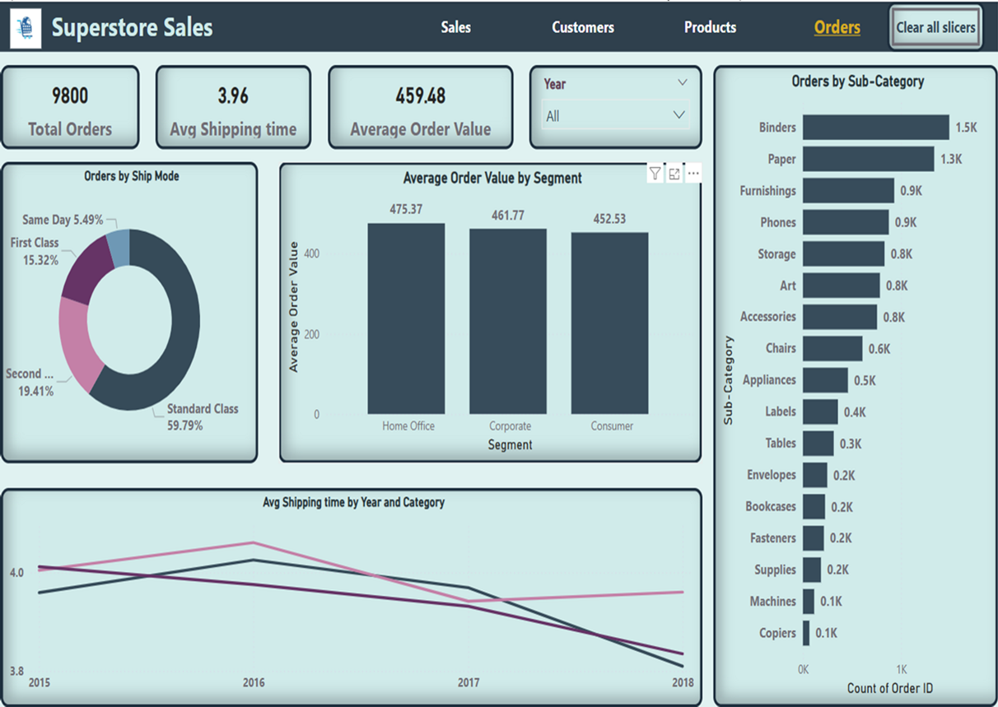
Creating Dashboard

Slide 14
Thank You

